Slide 1
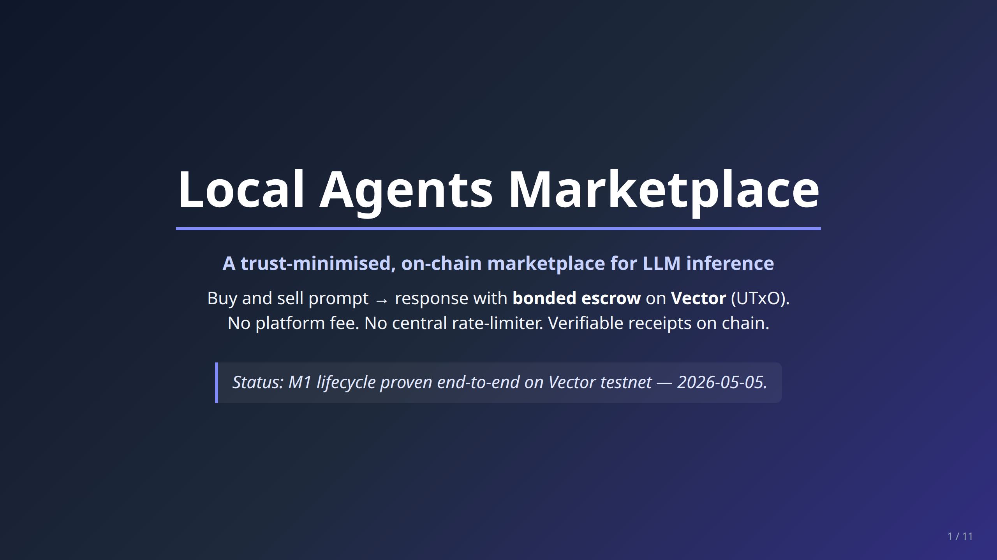
Notes:
EXECUTIVE_SUMMARY.md — slide-style overview of the Local Agents Marketplace.
Build PDF + PPTX with: bash docs/build-deck.sh
Edit this file; mermaid blocks are pre-rendered to docs/img/diagram-*.png.

Slide 2
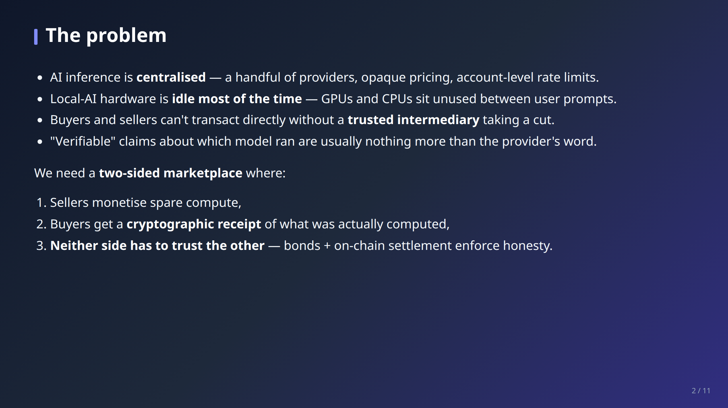

Slide 3
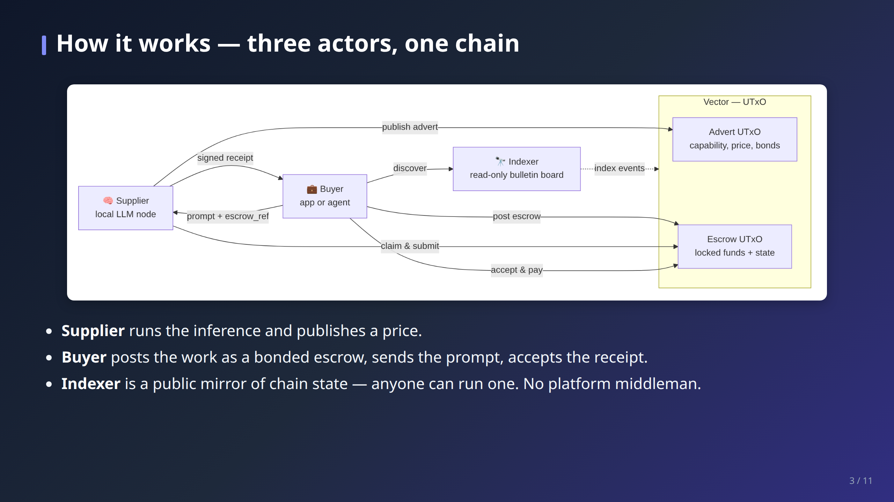

Slide 4
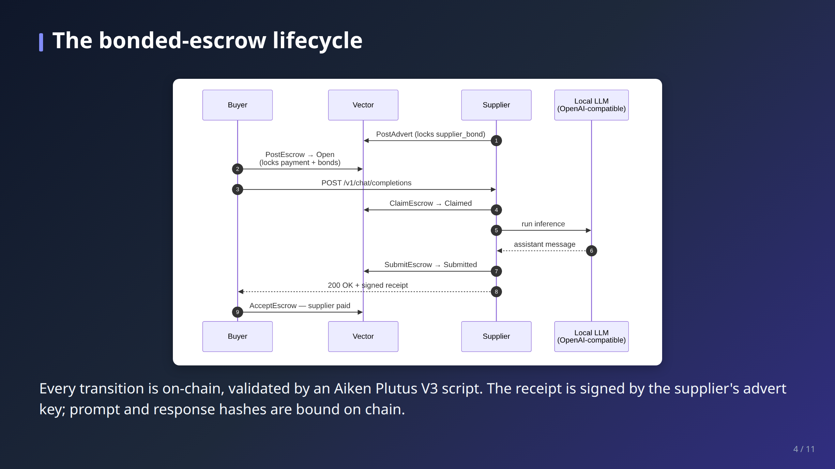

Slide 5
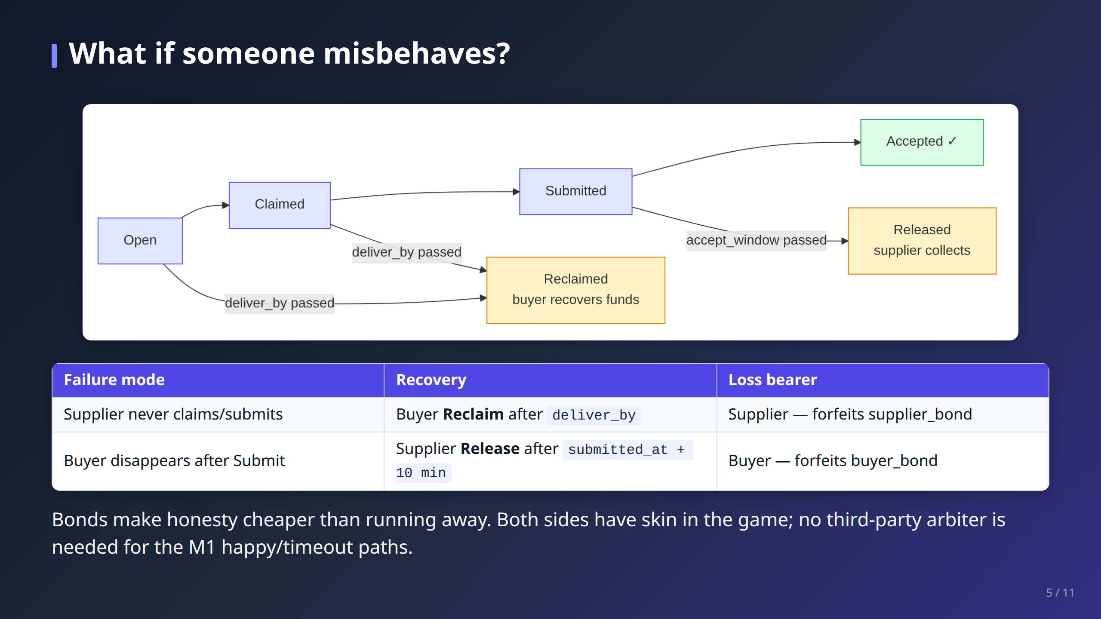

Slide 6
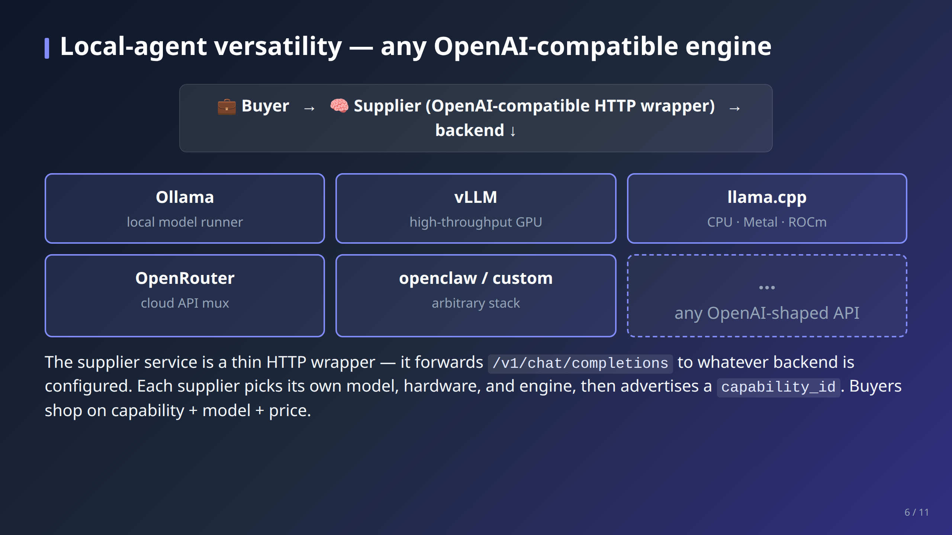

Slide 7
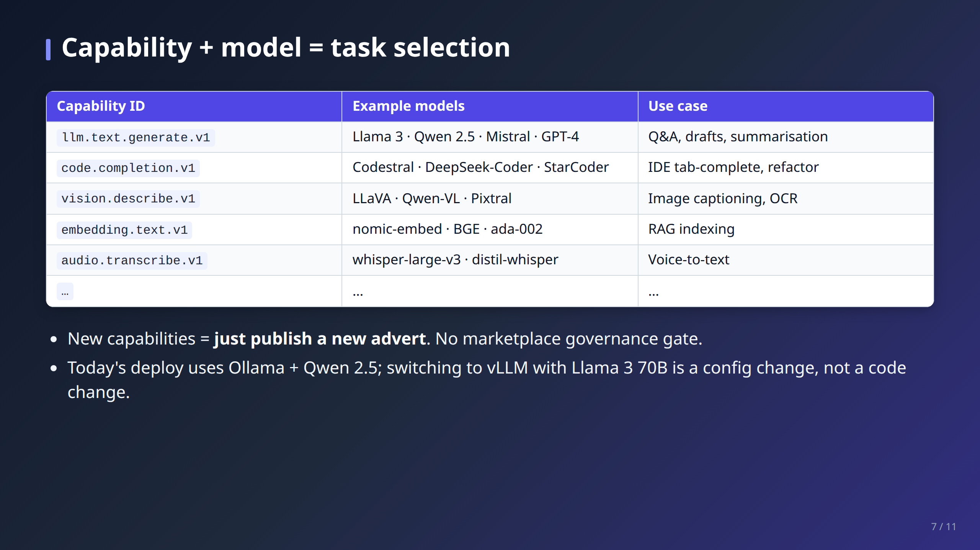

Slide 8
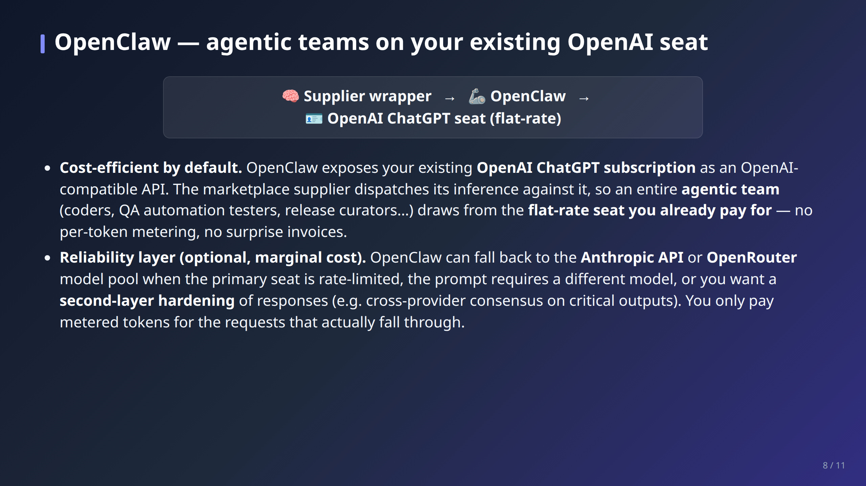

Slide 9
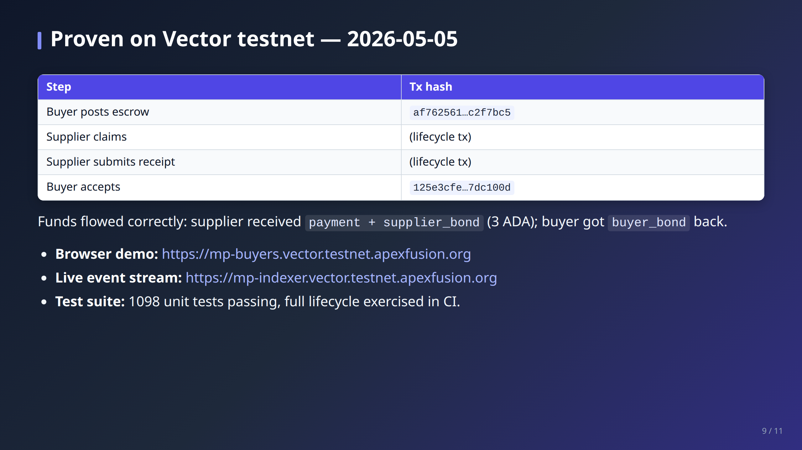

Slide 10
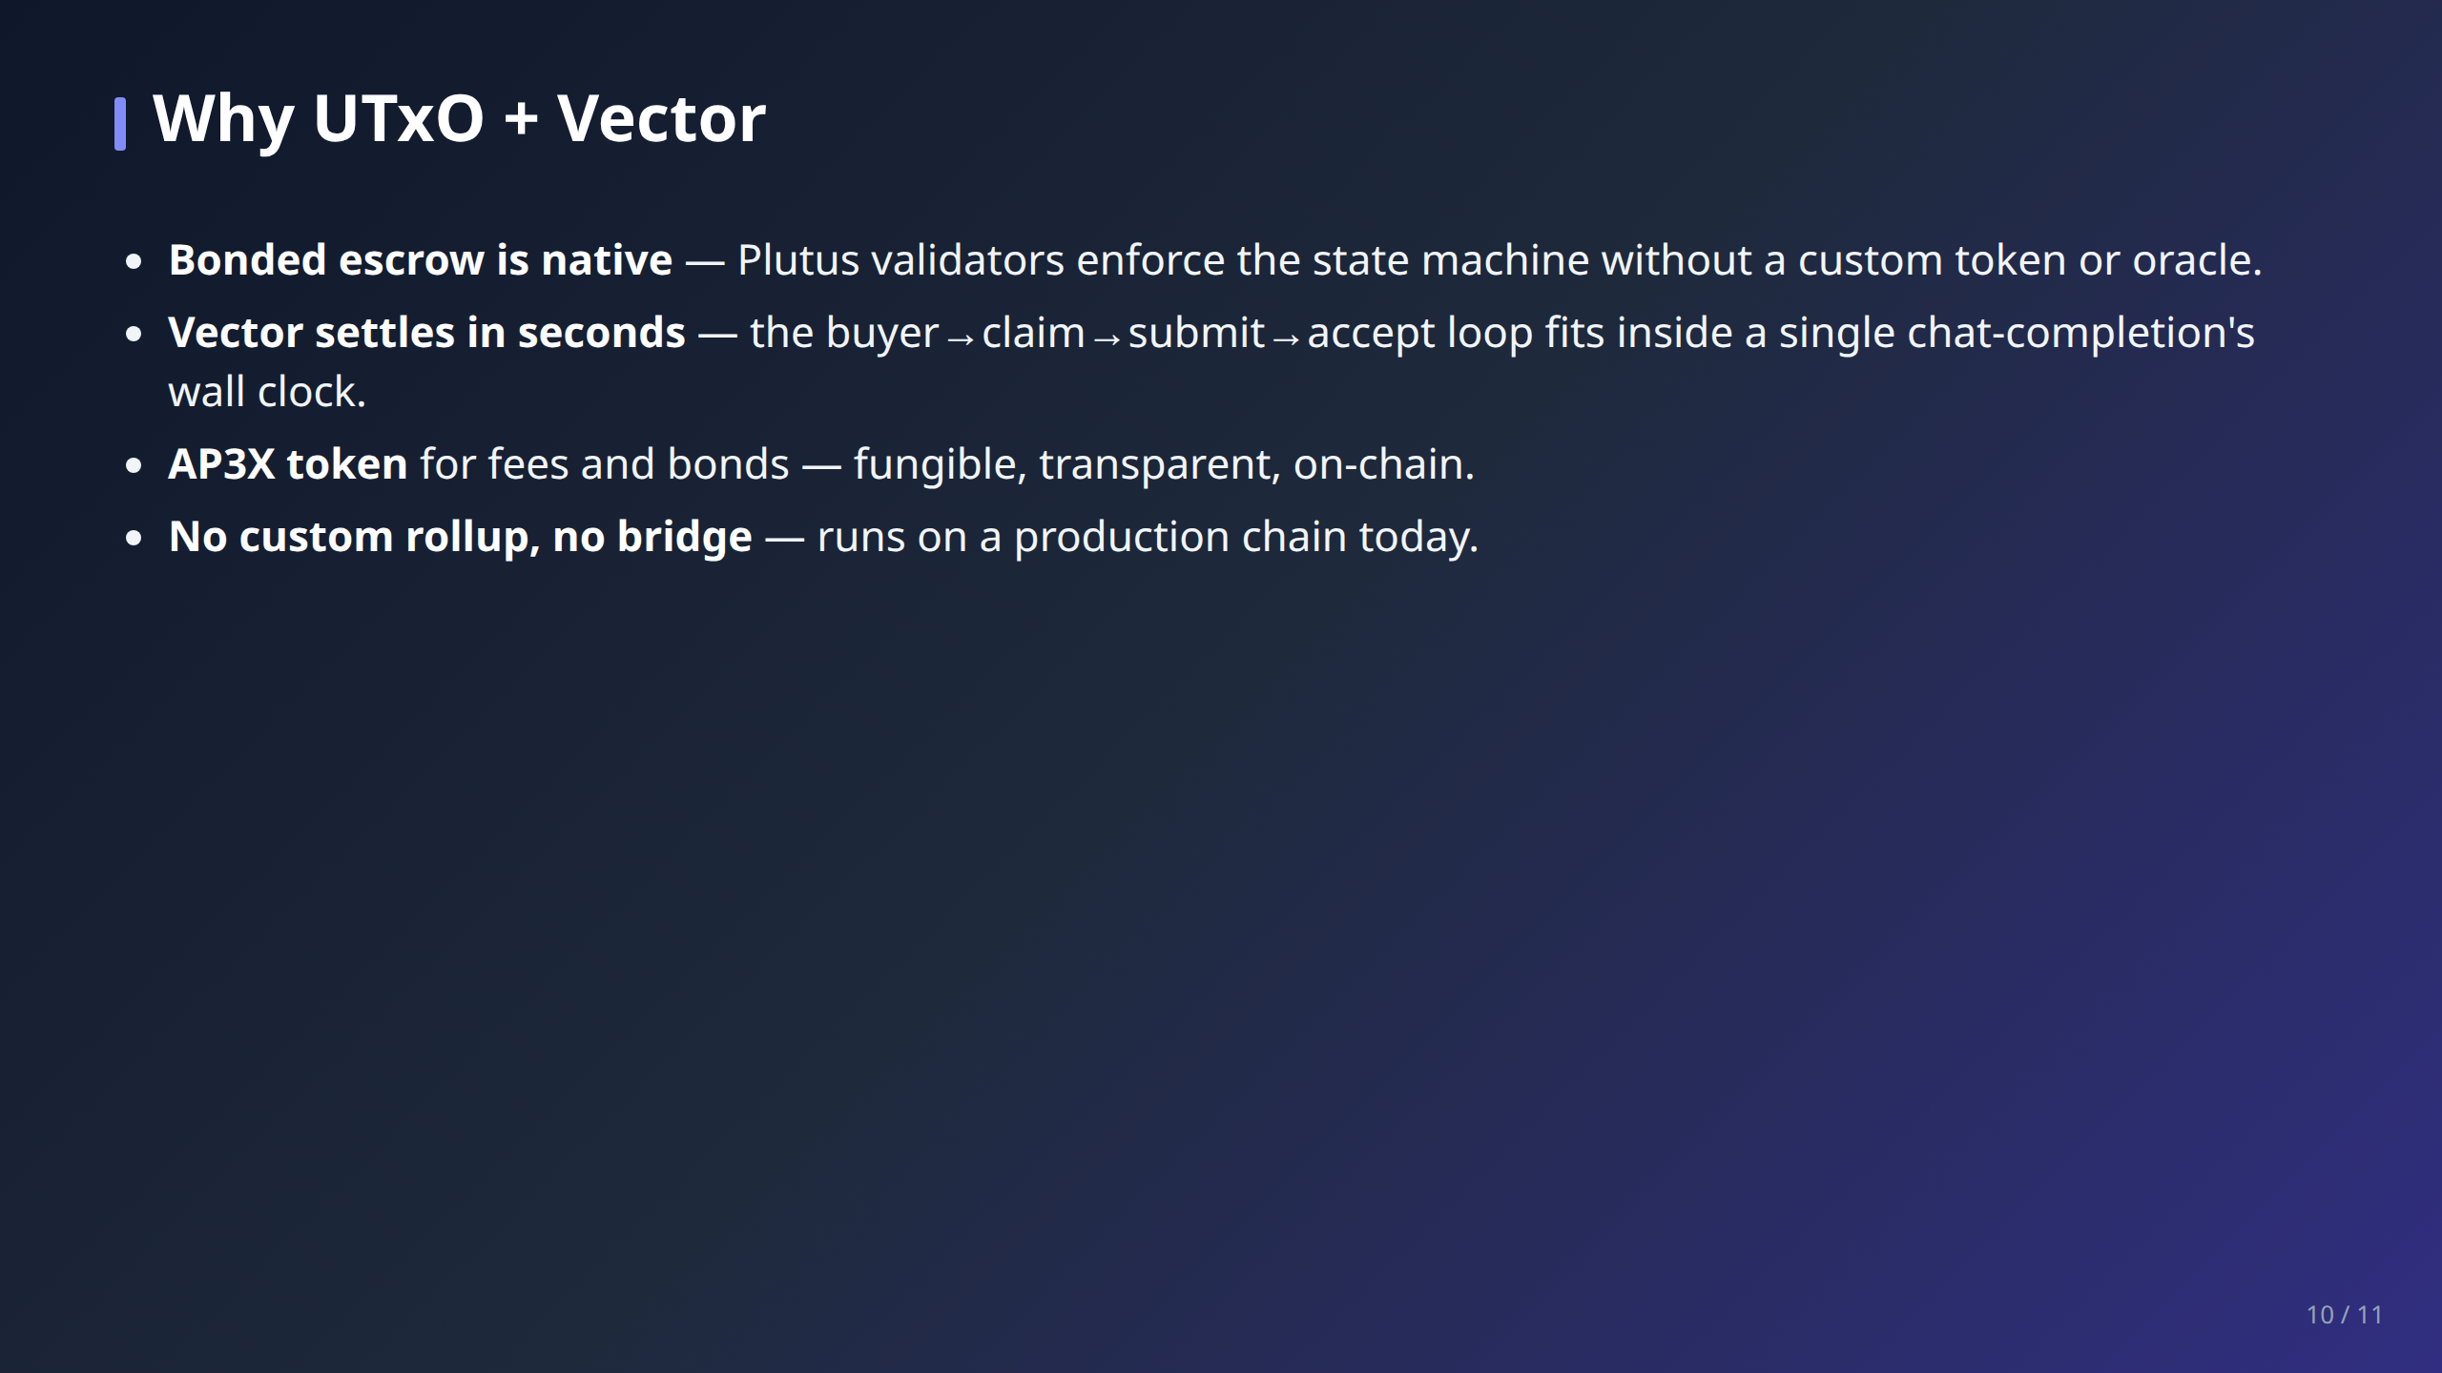

Slide 11
